Slide 1


CHEMEKETA FOUNDATION SCHOLARSHIP APPLICATION PROCESS

Slide 2

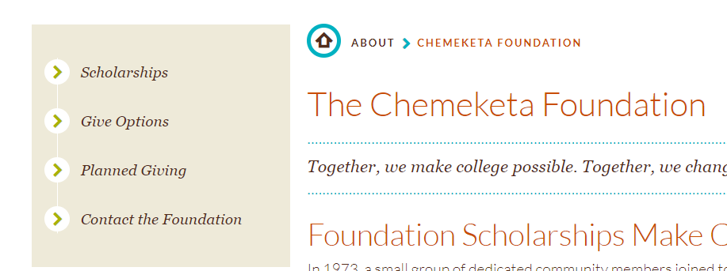
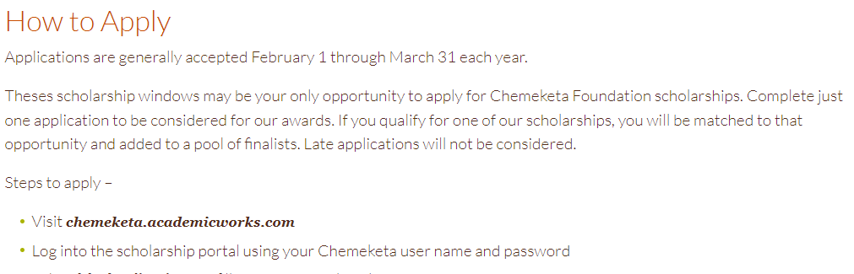

Access the online scholarship application at Chemeketa.academicworks.com or the foundation website at go.chemeketa.edu/foundation
On the foundation website,
1. Click Scholarships on the left side menu.
2. Scroll down to the How to Apply section and click on
Chemeketa.academicworks.com

Slide 3
SCHOLARSHIP APPLICATIONS ARE AVAILABLE FROM FEBRUARY 1 TO MARCH 31.
AWARDS WILL BE FOR THE ACADEMIC YEAR 2024 – 2025 (FALL, WINTER AND SPRING TERM).
Scholarship Application Instructions:
Log into Chemeketa.academicworks.com during the application period.
If you are not a current student at Chemeketa, apply for admission.
Before you begin, complete the FAFSA or ORSAA /EFC calculator to obtain the SAI (Student Aid Index) which is required on the application.
If you haven’t received the SAI from FAFSA, enter zero (0) to complete and submit the application. Once you receive the SAI from FAFSA, you can log back in and update it before the application deadline.

Slide 4

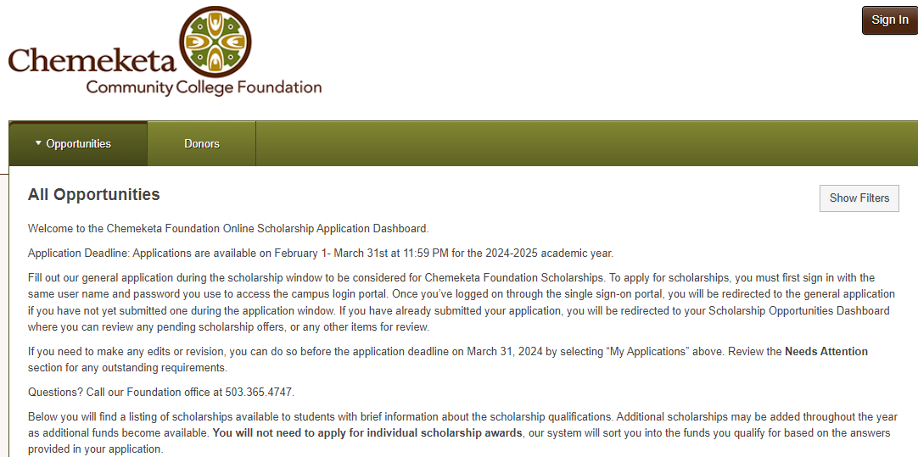
Read the information carefully and completely before you sign in.

Slide 5
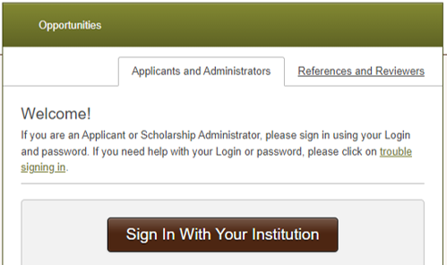
Before you click on “Sign in With Your Institution” make sure the Applicants and Administrators tab is selected.

Slide 6

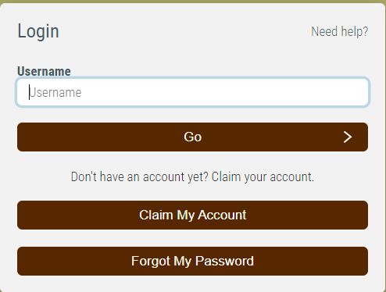
To access the application, you need to login.
Current students use your Chemeketa Single Sign on (SSO).
New students need to apply for admissions to obtain a username and password. It will take up to 10 days to process your admissions form. Do not wait until the deadline.

Slide 7
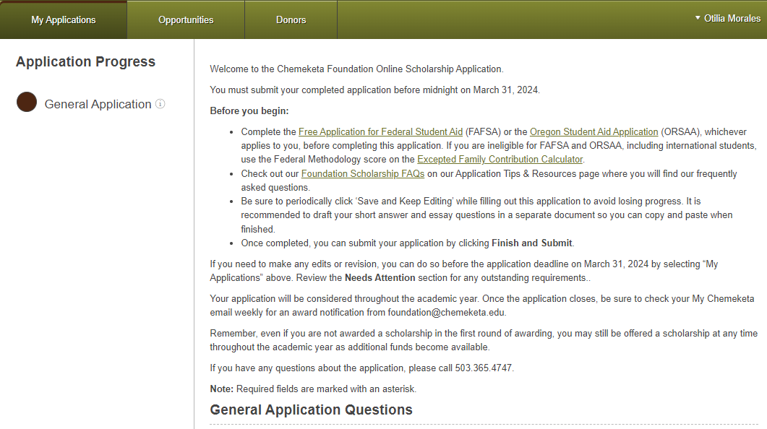
The General Application is in the My Application tab (top left corner). The Student Aid Index (formerly EFC) is required on the application. If you haven’t done so, you will need to complete the Federal Application Student Aid (FAFSA) or the Oregon Student Aid Application (ORSAA) and/or the Expected Family Contribution Calculator for the Student Aid Index value (in Results page).

Slide 8
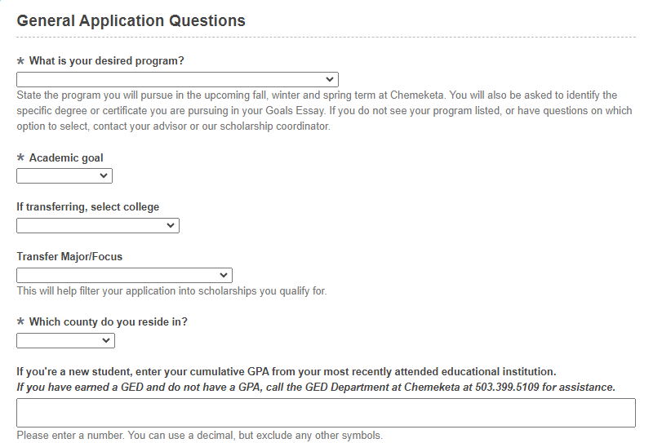
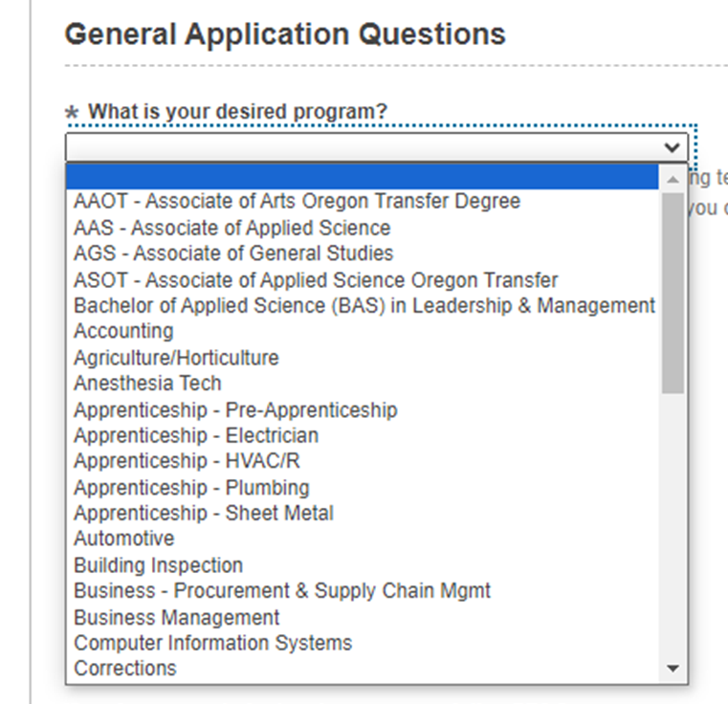
Select the program you are pursuing or will pursue next year, if it will change. Answer all the starred questions. Click on the drop down arrow for a list to select from. If you received, or will receive a GED certificate, contact the GED department to assist you in converting your scores to a GPA score you can enter on the application.

Slide 9
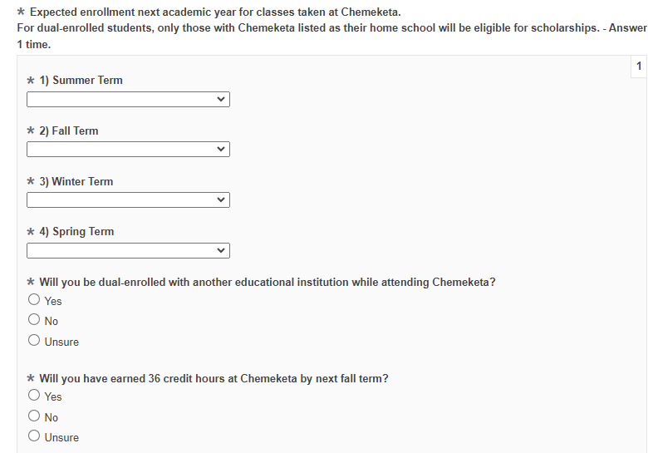
Select your enrollment plans for each term (Fall 2024, Winter 2025 and Spring 2025). This is for the next academic year. You can update the information up to the end of the application period.

Slide 10
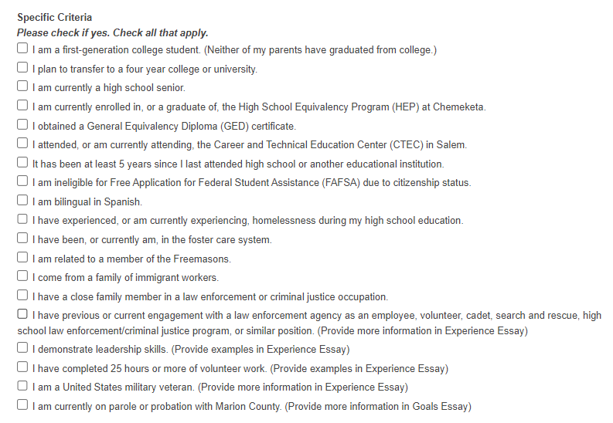
Statements are for scholarships that have specific criteria or preference. If none apply, you will be considered for scholarships pursuing any certificate or degree.

Slide 11
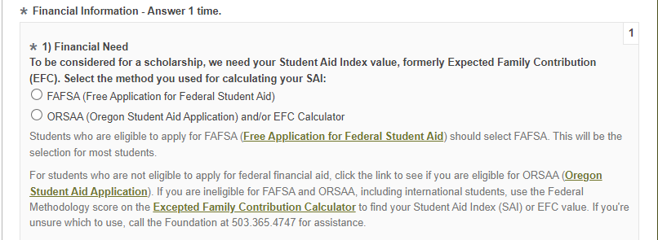
Select the method used to calculate the Student Aid Index value (SAI) formerly the Expected Family Contribution (EFC) score.

Slide 12
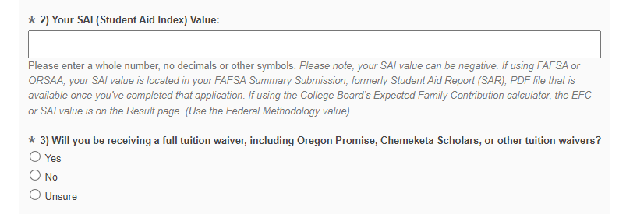
The SAI is required on the application. If FAFSA has not given you the SAI value, enter last year’s EFC score or zero (0). This will enable you to finish complete the application and submit it.
Once you receive the SAI from FAFSA, you can log back in and update it before the application deadline.

Slide 13
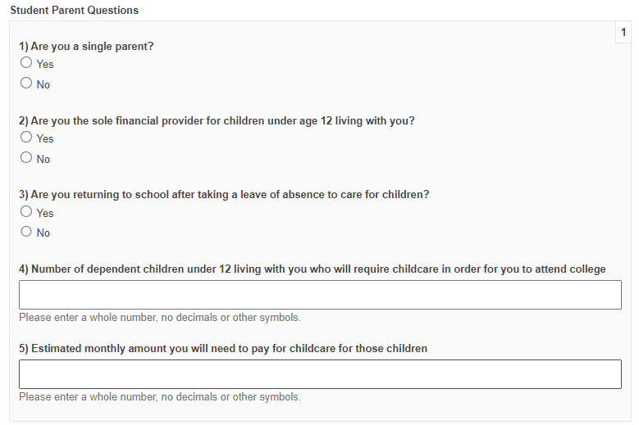
This question is to the Student – if you are a parent with a child or children under 12 years, who is/are your dependent(s) and require(s) childcare.

Slide 14
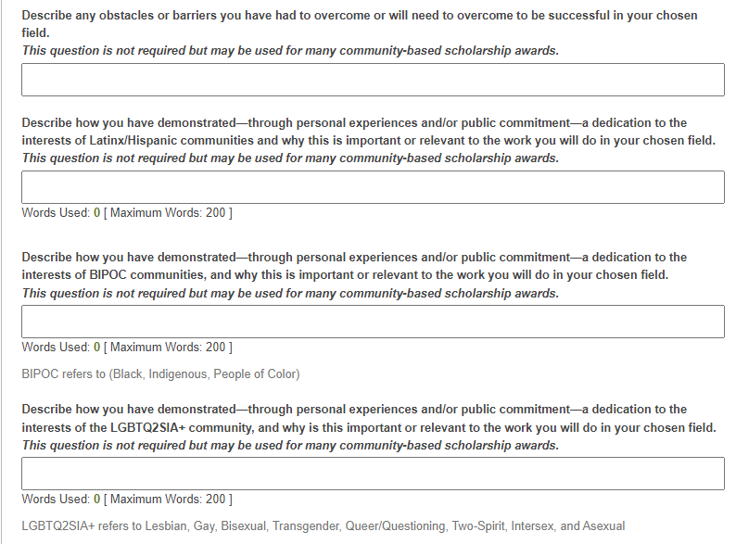
Short essays are not required. However, if you submit an essay, your application will be considered for additional scholarships.

Slide 15
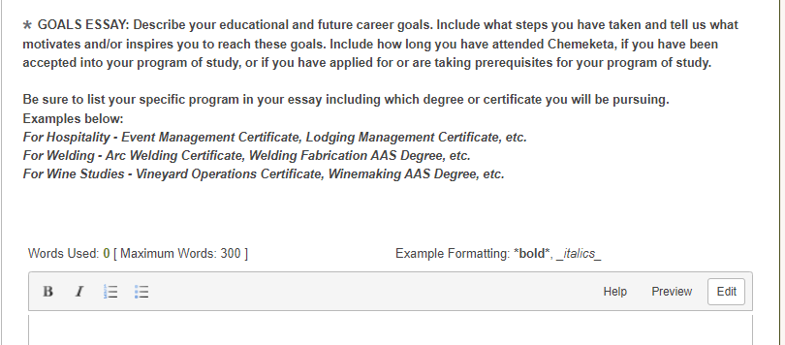
Tell us your story. Why are you attending college and what are your academic goals? When and how did your interest in your program of study start? Where are you from? What motivates you to continue? Are you currently taking prerequisites, or have you been accepted into the program? Why should the scholarship committee award you the scholarship?

Slide 16
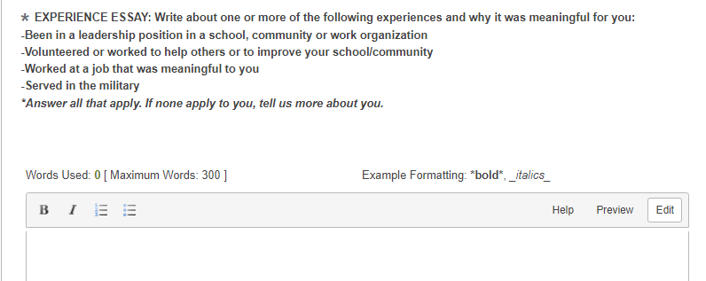
If you do not have leadership experience, volunteer/community service, work or military experience, please tell us more about you so we can see what scholarships may best help your academic journey.

Slide 17
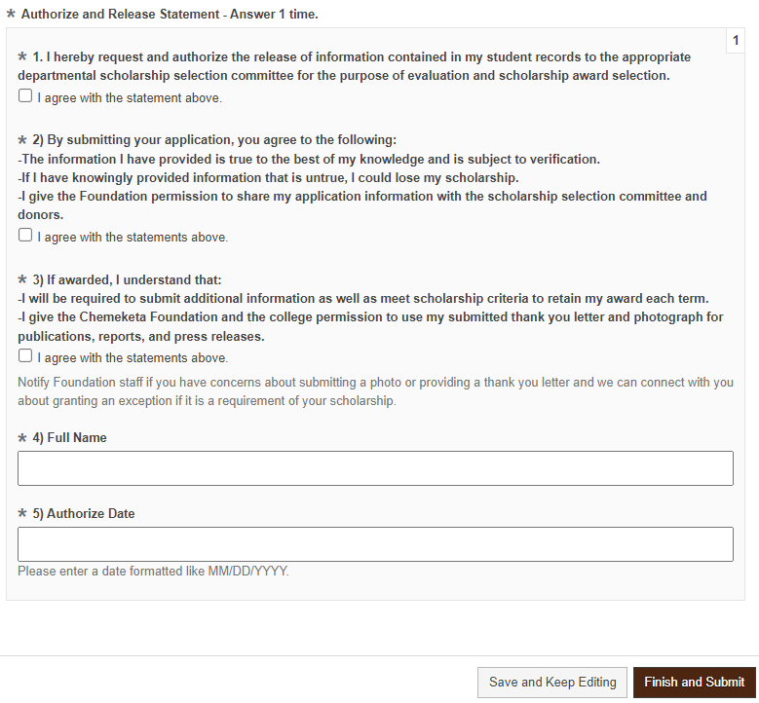
Read each section carefully before you check the box. Enter your name and date. At the bottom of the page, click on the button “Finish and Submit” or “Save and Keep Editing” to update your application at a later time.

Slide 18
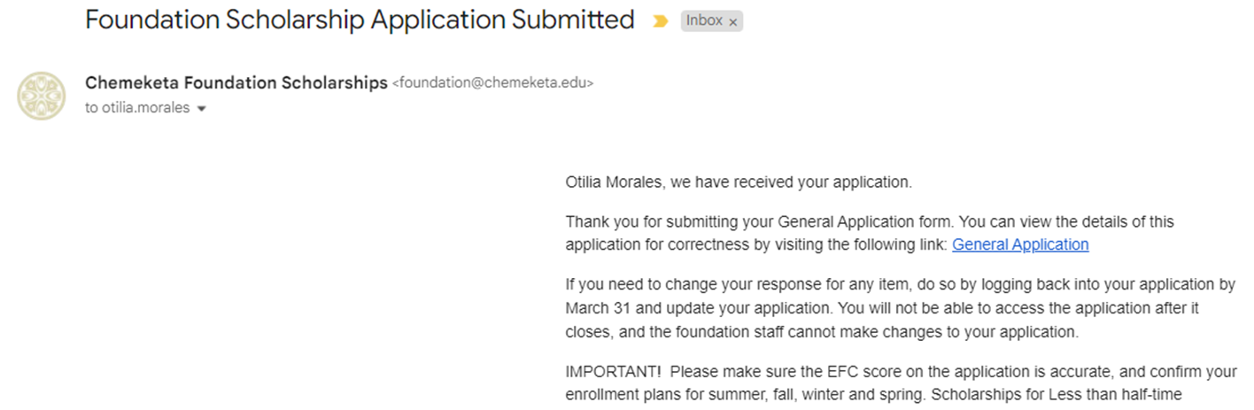
After you submit the application, you will receive a notification stating your application was received. Read the information thoroughly. Click on the “General Application” link to review details from the application.

Slide 19
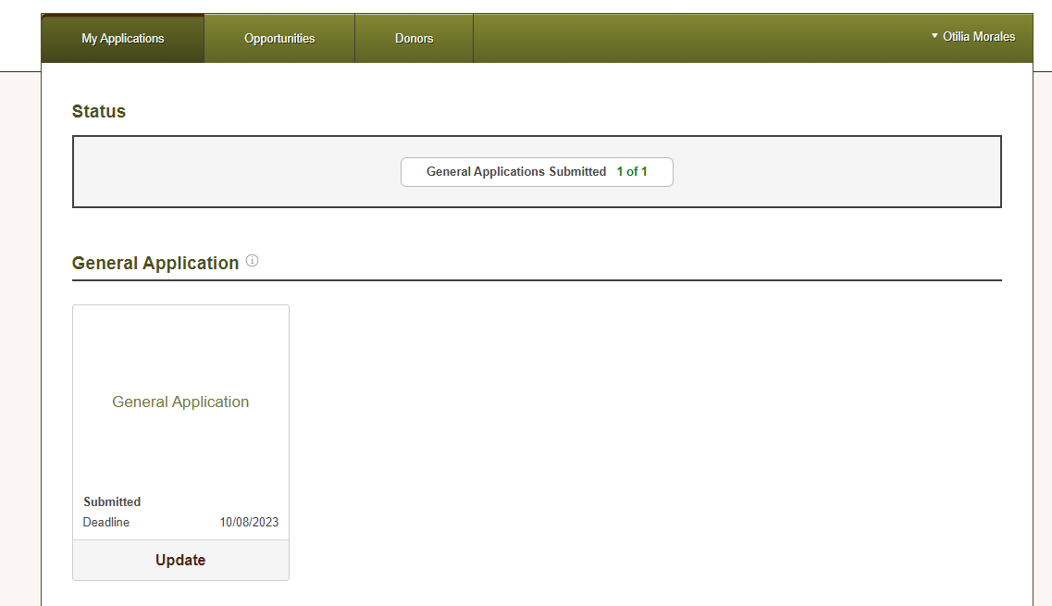
If you need to change your response, do so by logging back into the application by the deadline. Once you have submitted the application, your status will say, General Application 1 of 1. Otherwise, it will state 0 of 1, which means the application has not been submitted. Click on Finish to complete the application.

Slide 20
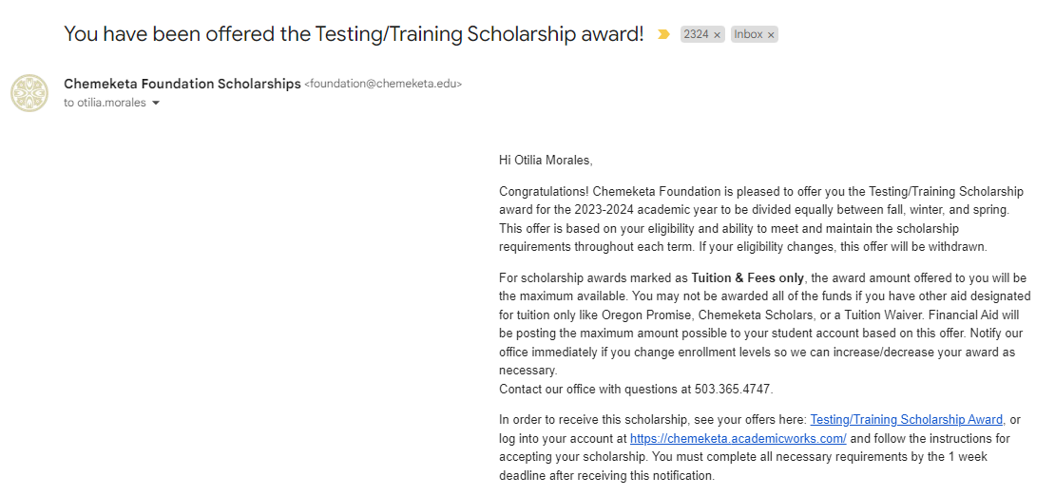
If selected for a scholarship, you will receive a notification at your My Chemeketa email address. It will be from the Chemeketa Foundation Scholarships. Read it thoroughly. To view the scholarship offer click on the scholarship award link or log back into the scholarship portal at chemeketa.academicworks.com.

Slide 21

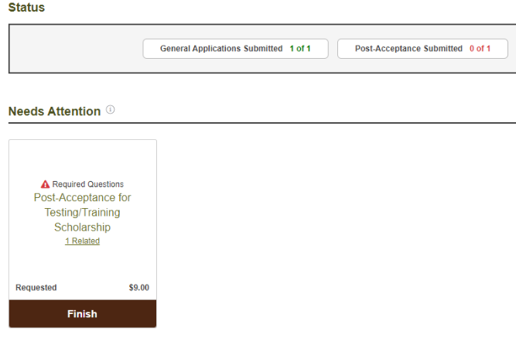
You will see the Post–Acceptance for (name of scholarship) in the scholarship portal. Click on “Finish” to review the scholarship information and to accept.

Slide 22
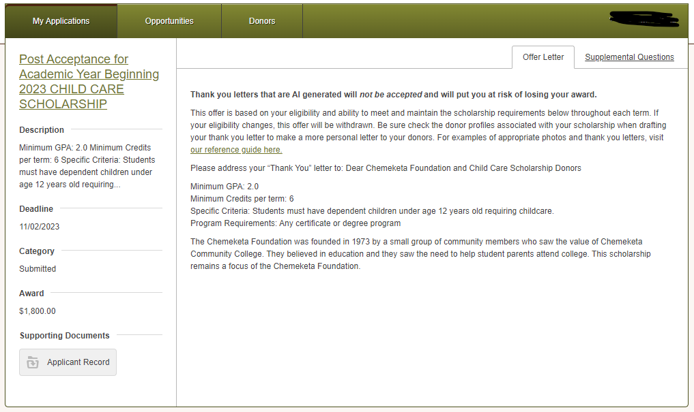
Read the scholarship information and accept the offer. To view examples of photos and thank you letters, click on “ Our reference guide here.” Then select the Supplemental Questions tab to complete the acceptance.

Slide 23
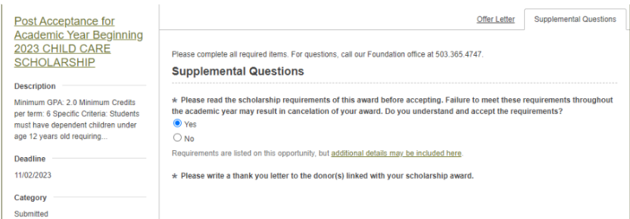
Read the scholarship information and accept the offer. Then select the Supplemental Questions tab to complete the acceptance. If you are unable to answer the questions, it could be the deadline to accept it has passed. Contact the foundation. To view scholarship requirements, click on the “additional details may be included here” link.

Slide 24
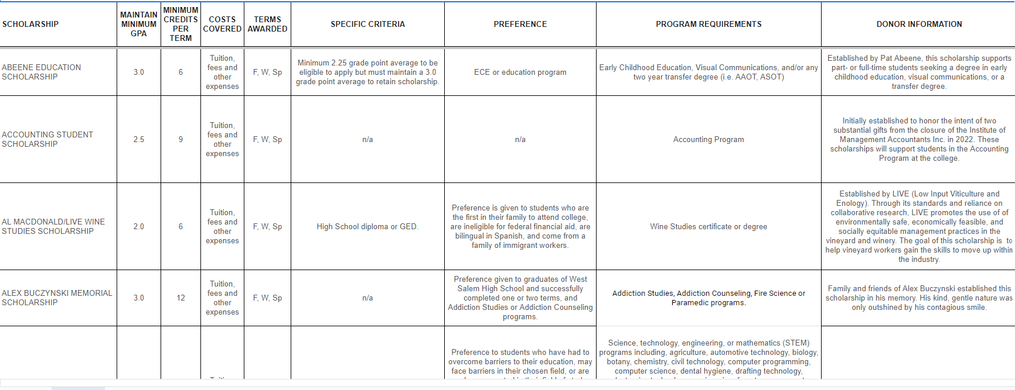
The “additional details may be included here” link will direct you to a list of scholarships (in alphabetical order). Review the requirements and cost covered by the scholarship. You must maintain the minimum requirements to retain scholarship.

Slide 25
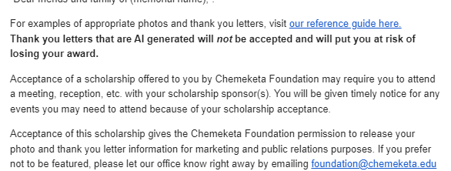
You are required to submit a thank you letter to the donor. On the award notification sent to your My Chemeketa email, there is the “our reference guide here” link for examples of thank you letters and appropriate photos to submit. Note: Thank you letters that are Al generated will not be accepted and will put at risk of losing the award

Slide 26
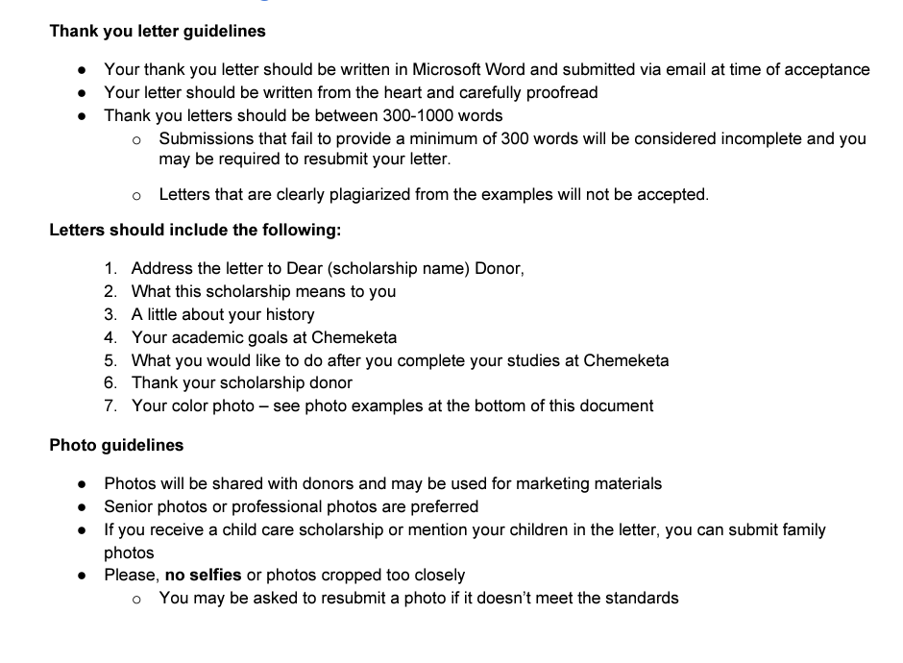
The “Our Reference Guide” link will direct you to the list of guidelines below. It also provides examples of acceptable thank you letters and photos for you to use as a reference.

Slide 27
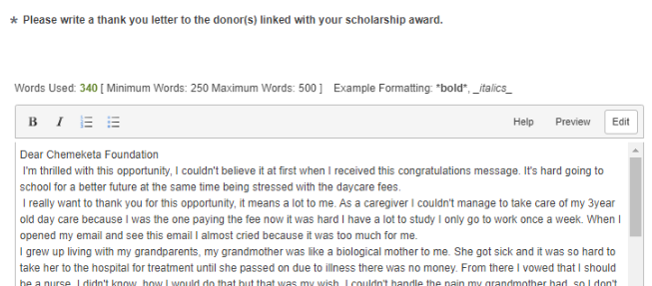
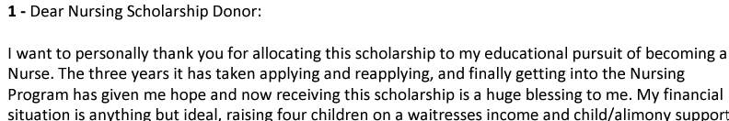
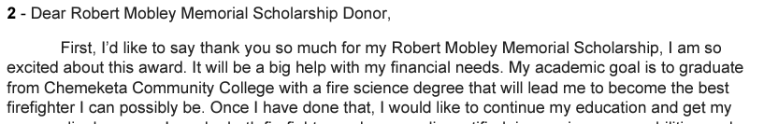
Examples of thank you letters.

Slide 28
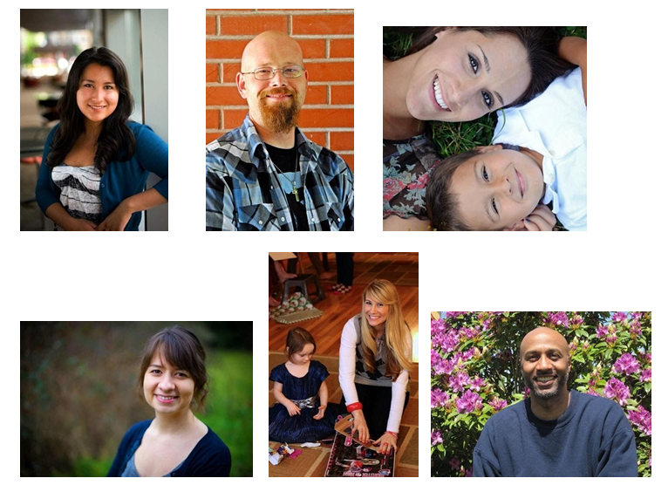
Examples of photos that are acceptable. No close up selfies or group photos. You may be asked to submit another photo.

Slide 29
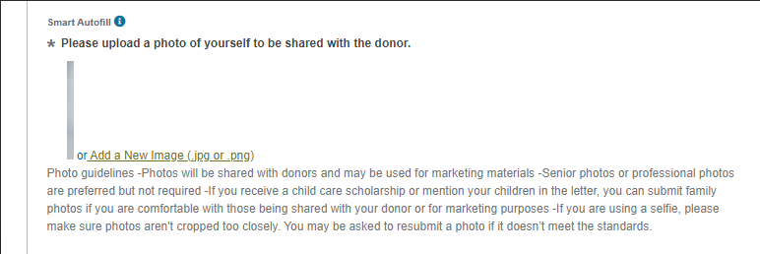
In addition, you will need to submit a current photo. It does not have to be a professional photo but one we can share with the donor and/or use for marketing materials. If offered the Child Care Scholarship, submit a photo of you and your children when possible.

Slide 30
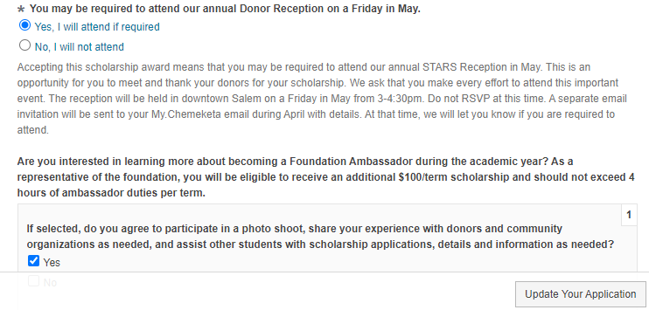
Finish answering the Supplemental Questions and click on “ Update Your Application” to submit. This will complete the acceptance of the scholarship offered. If you are offered more than one, you will need to complete this process for each scholarship.

Slide 31
What happens after I accept the scholarship?
The Financial Aid Office will be authorized to post scholarship funds to your student account.
Scholarship funds will be used to pay off balance due. If you don’t have a balance, it may issue funds directly to you. This depends on the scholarship and what it covers.
Your academic progress is reviewed throughout the term. Recipients must maintain the minimum requirements each term to retain the scholarship.
Scholarship funds will post to the student’s account the first week of each term.
If requirements are not met, the scholarship may be canceled or placed on warning status.

Slide 32
foundation@chemeketa.edu or at 503-365-4747
Website: go.chemeketa.edu/foundation
Building 5, Room 264
Questions?
Otilia Morales
Scholarship Coordinator
Chemeketa Foundation
otilia.morales@chemeketa.edu
503.399.6990
Jamie Wenigmann
Director of Development
Chemeketa Foundation
jamie.wenigmann@chemeketa.edu
503-399-5148

